Slide 1
Intrado/West Churn Model
Group 2: CHAD CROWE, EL KERNS, AND JODI SANGSTER

Slide 2
Business and Data Understanding

Slide 3
Data Preparation
Factor cleaning:
Numeric categories converted to factors
Levels indicating missing converted to NA
Spaces removed from levels with make.names
Variable elimination
Variables with 100+ levels removed
Variables missing for >50% of observations removed
Variables contained within other variables were also eliminated (e.g. line of business falls within major industry category)
Missing values
Factor-level ‘missing’ used in place of NA for any missing
Numeric missing will be imputed within each model cross-fold by BagImpute
Multicolinearity
Total_transactions and total_products were found to be strongly correlated
Derived variables
Avg. Transactions per product = Total_transactions/
total_products
Proportion Missing: # of variables with missing values (derived before any missing eliminated)
Notes:
Final dataset contained 30 variables and 24,649 observations

Slide 4
Overall Modelling Plan
Training Data Split into 70% Test/30% Train
KNN
(5-fold cross-validation selection of k)
LASSO
(5-fold cross-validation selection of λ)
BCT
(5-fold cross-validation selection of B, λ, & d)
undersampling
No sampling
Undersampling
No sampling
Undersampling
(X2: with and without standardizing umeric variables)
No sampling
(X2: with and without standardizing numeric variables)
total_transactions
total_transactions
total_transactions
total_transactions
total_transactions
total_transactions
total_products
total_products
total_products
total_products
total_products
total_products
total_transactions/
total_products
total_transactions/
total_products
total_transactions/
total_products
total_transactions/
total_products
total_transactions/
total_products
total_transactions/
total_products

Slide 5
Model-set 1: K-Nearest Neighbors
Variable Included | Sampling Type | Final Parmaeters | AUC
Transactions | None | K = 1 | 0.579
Transactions | Under | K = 1 | 0.592
Products | None | K = 1 | 0.589
Products | Under | K = 1 | 0.557
Transactions/Product | None | K = 1 | 0.537
Transactions/Product | Under | K = 1 | 0.581
Why KNN?
Non-parametric method
Based on clustering
Very flexible
High bias
ROC Curve for Final KNN Model
Technical Specifications:
knn model type from the caret package
K’s tested using a grid search from 1:20
Imputed test values before training
Prevent a bias for k = 1

Slide 6
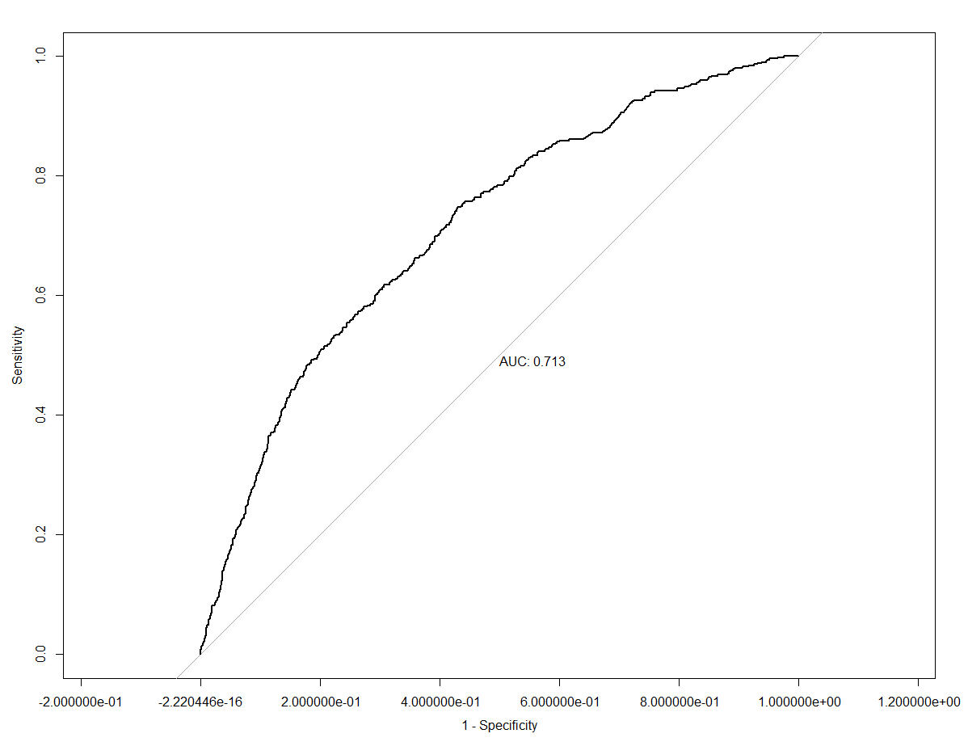
Model-set 2: Least Absolute Shrinkage and Selection Operator (LASSO)
Variable Included | Sampling Type | Final Parmaeters | AUC
Transactions | None | λ = 0.0036 | 0.7014
Transactions | Under | λ = 0.0215 | 0.6945
Products | None | λ = 0.0013 | 0.6679
Products | Under | λ = 0.0215 | 0.6610
Transactions/Product | None | λ = 0.0013 | 0.7130
Transactions/Product | Under | λ = 0.0013 | 0.7110
Why LASSO?
Performs better than OLS when there is:
multicollinearity
Poor ratio of observations to variables (p>N)
Does not require the assumptions about data distribution
Avoids overfitting
Performs variable selection
ROC Curve for Final Model
Technical Specifications:
Glmnet model in the caret package
Lambda’s tried using a grid search with selection set to within 1 standard error of that producing the max ROC
Starting with 10 values between 0.01 and 1
Range narrowed with each run until all values within 1 standard error of the peak
Final ‘Selected’ Variables:
total_accounts
Business_Code
Subsidiary_Indicator
Legal_Status_Code
Currency_Code
Population_Code
Hierarchy_Code
Revenue_US_Dollars_
Number_of_Family_Members
Major_Industry_Category_Name
TransactionsPerProduct

Slide 7
Model-set 3: Boosted Classification Tree (BCT)

Slide 8
Model Evaluation & Selection
Selected Model:
Boosted
Uses the variable
Total Transactions
No under sampling
Model | Worst | Best | Range
KNN | 0.537 | 0.592 | 0.055
LASSO | 0.661 | 0.713 | 0.051
Boosted | 0.713 | 0.762 | 0.049
Parameter | Optimized Value
nrounds | 140
max_depth | 7
eta | 0.05
gamma | 0.05
colsample_bytree | 0.5
min_child_weight | 3
subsample | 1
Model | Performance (AUC)
KNN | 0.592
LASSO | 0.713
Boosted | 0.762

Slide 9
Recommendation/Conclusion
AUC ~= 0.76
some confidence we can provide a good indication of churn
The ROC has a nice curve
indicating an even tradeoff of sensitivity and specificity at any threshold
Predictions also come with class probabilities
Customer can customize how they use the probabilities
preventing churn might be expensive
so only target most likely to churn
Combine churn probability with client revenue

